Slide 1
Mixed Static, Colliding Echoes, & B(l)ackground Noise
Or, why this stuff is so hard to talk about and some other stuff to help contextualize what’s going on right now

Slide 2
“White” or “Outsider”
Histories of Black Aesthetic Materials

Slide 3
Sentimentality—19th Century
Harriet Beecher Stowe, Uncle Tom’s Cabin; or life among the lowly (1853)
Primarily aimed at women readers
Sought to cultivate a “refined moral sensibility.” Primers in how to “feel” the right way about social issues such as slavery.
Shortcomings
Advocates for an early form of what will later be known as “respectability politics.”
Preferred moralism over depiction of and engagement with thornier aspects of enslavement. (Physical and psychic pain of the subjugated, racial colonialism and its relationship to economic prosperity and comfort for certain groups of whites).

Slide 4
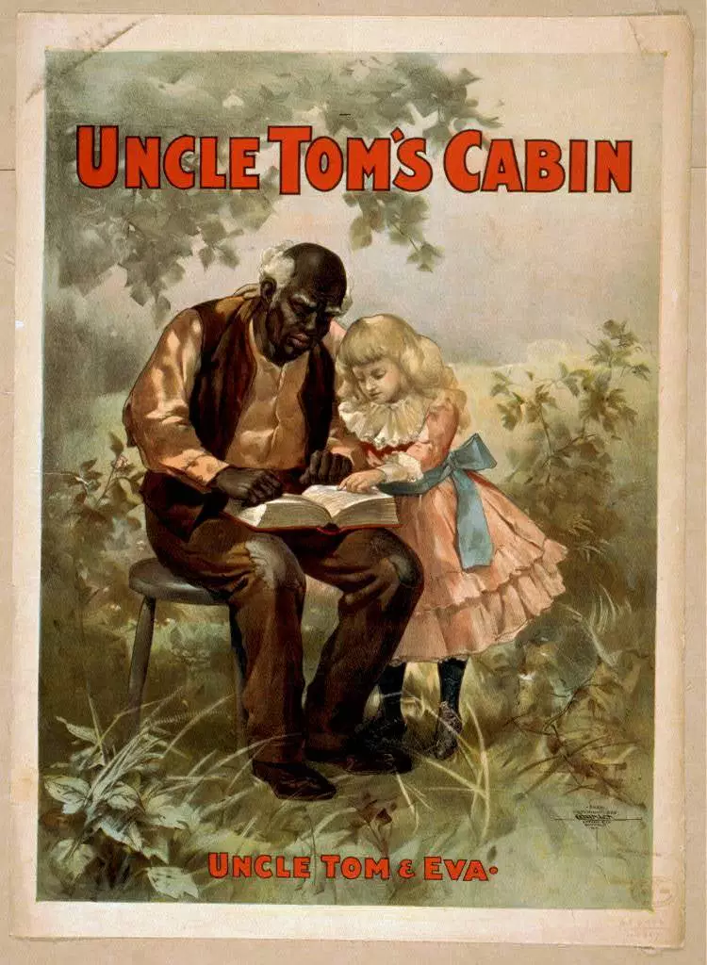
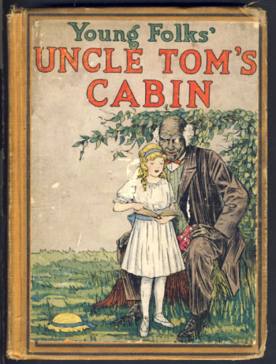

Slide 5
Primitivism—20th Century
Originates primarily in the visual arts.
Appetite for the “exotic other” whose “raw” and “unmediated relationship to the body” offers routes out of a rote, alienating, and mechanized modernity.
Shortcomings
Black bodies (and culture) often became surfaces for the projection of white colonial fantasies of escaping modernity.
Hypersensualized and sexualized black bodies and cultures in ways that ultimately still made them inferior to the (sentimentally) refined and disciplined intellectual capacity of Western cultural. Sometimes “primitive others” become “noble savages.”
The “African Objects” of interest, both museum objects and black persons in the Western world, arrived in those places because of colonialism—a forcible taking of bodies and things from their original context.
A weaker agent culture (black) was used for the monetary profit and accumulation of cultural capital of a stronger agent culture (white). This is one definition of appropriation—a relationship of strong agents to weak agents.

Slide 6
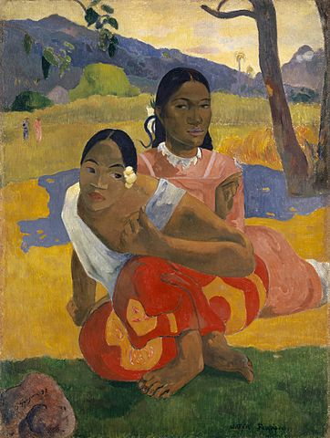
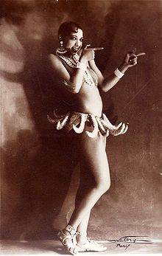
Paul Gaugin
When will you marry? (1892)
Sold for $300 million in 2015
Josephine Baker
1906-1975

Slide 7
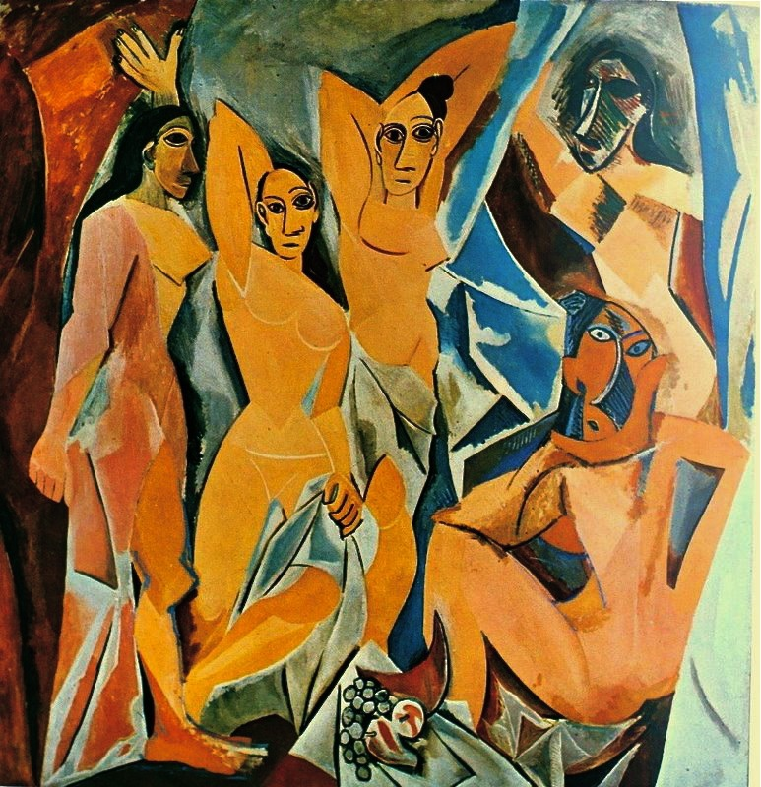
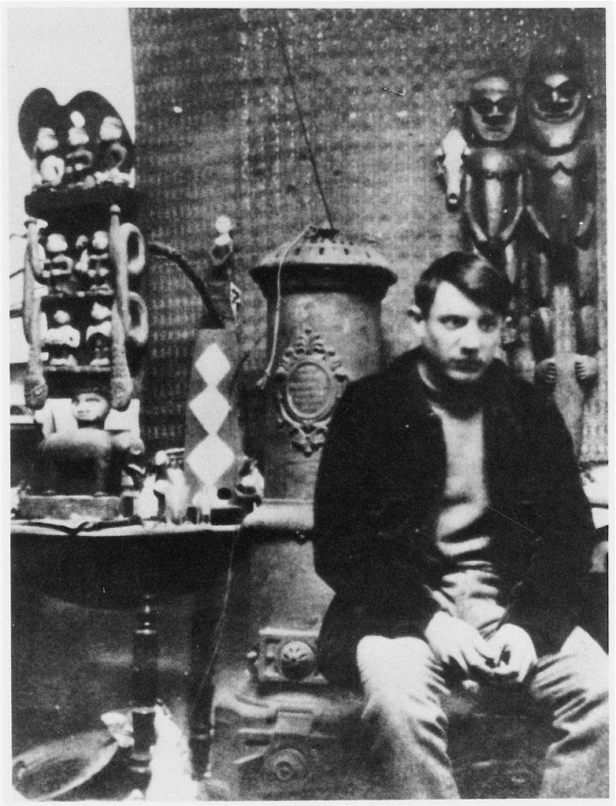
Pablo Picasso, Les desmoiselles d’Avignon
1907

Slide 8
Performative “Woke-ness”
Extension of Civil Rights and anti-racist movements
Call out culture
“Cancelling” (the boycott)
Shortcomings:
Runs the risk of mystifying structural, ideological, and psychic histories that produce moments of racism in favor of focusing on specific instances.
Functions within an affective (emotional) politics of shame and guilt that can have limited political efficacy while intensifying bi-polarization of culture (us vs. them/ good vs. bad).
Draws attention to performances of good allyship rather than conditions of those most adversely affected, thereby consolidating cultural capital for ally’s rather than redistributing attention or resources to the structurally underprivileged. (e.g. “The Good Gentrifying University,” “The ‘Social Justice’ Instagrammer”)

Slide 9
Shortcomings cont’d
Like sentimentalism, performative “woke-ness” runs the risk of turning everything into an issue of personal feeling while leaving larger racist structures and histories intact and uninterrogated. In the literature classroom it runs the risk of reducing all aesthetic objects to symptoms of larger social and historical issues.
Can operate on a politics of inversion that, again, leaves larger issues that produce the racism, sexism, homophobia, transphobia, etc. it seeks to combat intact. Politics of inversion are also dangerous as they are imbricated in fantasies of pure innocence that flatten the personhood of “victims.” Those who experience discrimination or structural violence are then always marked, defined, and over determined by that injury.
Flattened subjectivities hamper victims as much as they hamper our ability to grasp moments of continued transgressions. Over attributing minorities with injury/innocence can mask their own capacity to cause harm to others. (e.g., Asians can’t be racist, Blacks can’t be racist, Women can’t be sexist, Trans* folk can’t be classist, etc. etc.)

Slide 10
“Black” Aesthetics

Slide 11
Slave Narratives & Post-Bellum Black Cultural Production 19th Century
The History of Mary Prince, a West Indian Slave, as related by herself (1831), Mary Prince
Narrative of the Life of a Frederick Douglass, an American Slave (1845), Frederick Douglass
Incidents in the Life of a Slave Girl, as recounted (1861) Harriet Jacobs
Our Nig (1859) Harriet Wilson
Peculiar Sam (1879) Pauline Elizabeth Hopkins
These texts, written by the formerly enslaved—often fugitive as slavery is not “officially” abolished in the U.S. until after 1865—depict blacks as human record the physical and psychic exploitations of slavery. During slavery they work towards abolition. After slavery they work towards integrating the formerly-enslaved into a country still reeling over the effects of a civil war.

Slide 12
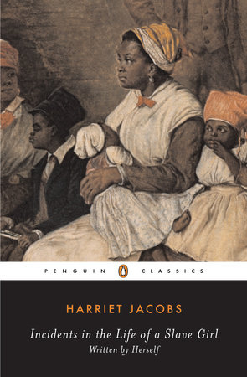
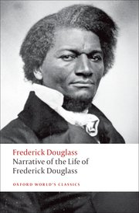

Slide 13
Harlem Renaissance—Early 20th Century
Harlem, a northern city, becomes a migration destination for Blacks during the first half of the 20th century.
Growth of a “Negro” middle class.
Billie Holiday, Duke Ellington, Louis Armstrong, Nella Larsen, James Baldwin, Josephine Baker, Claude McKay, Zora Neale Hurston

Slide 14
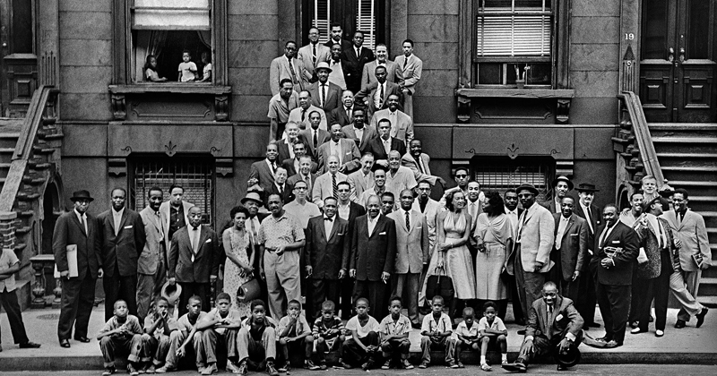

Slide 15
The Black Arts Movement—Later 20th Century
1965 Amiri Baraka opens the Black Arts Repertory Theatre in Harlem.
Argues for a black separatist aesthetic that builds on earlier black art and black social thought (e.g. Black Power Movement).
Audre Lorde, Nikki Giovanni, Sonia Sanchez, Amiri Baraka, AfriCOBRA

Slide 16
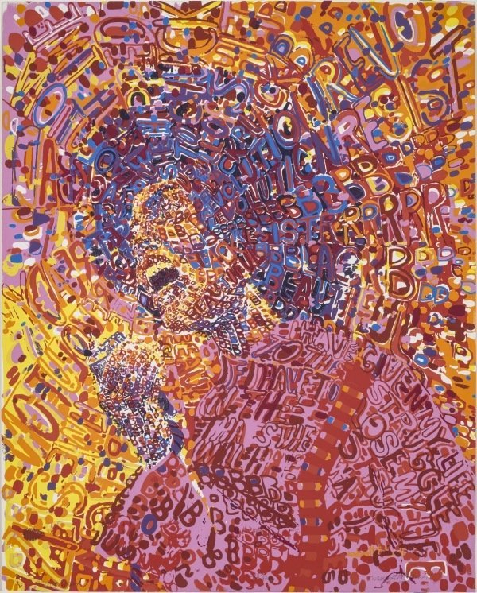
Jarrell Wadsworth,
Revolutionary 1972

Slide 17
Contemporary Black Poetics (20th & 21st Century)
Nathaniel Mackey
Fred Moten
Harryette Mullen
Simone White

Slide 18
Black “Popular” Sound
Minstrel Shows
Jazz
Hip-Hop
Rap

Slide 19
Contemporary Sonic “Black Queer Opacities”
NYC Vogue Ballroom Culture: MikeQ, Vjuan Allure
Experimental queer black sound: Juliana Huxtable, bearcat, le1f, Mykki Blanco, Cakes da Killa, Zebra Katz, House of LaDosha

Slide 20

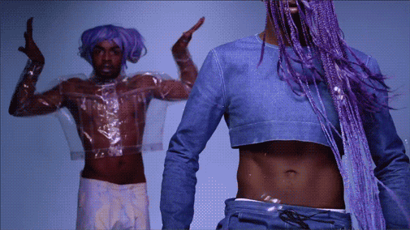
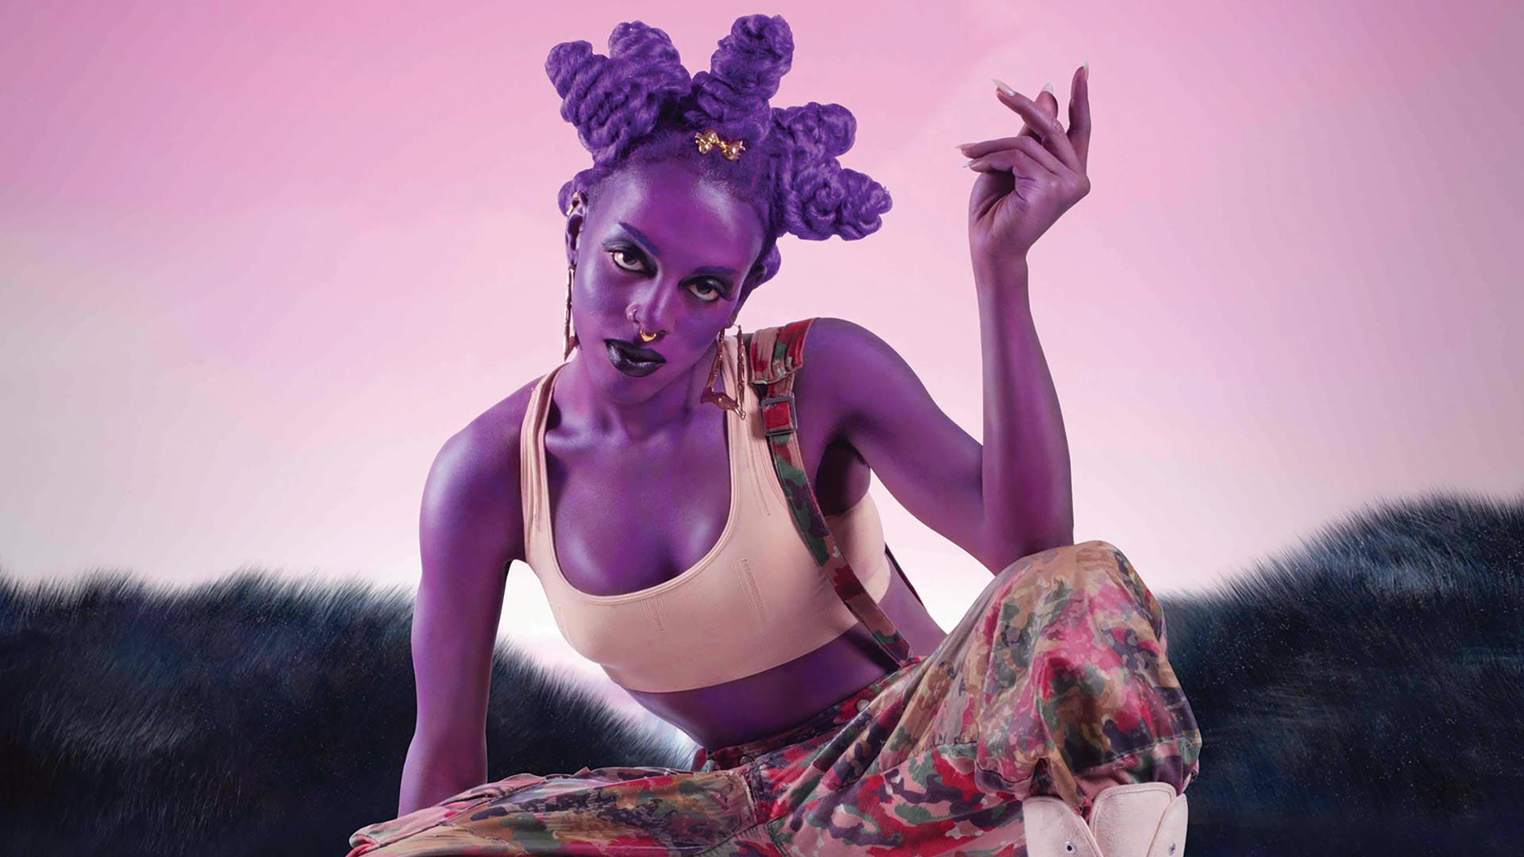

Slide 21
The agencies of opaque sound
Echoes that do not want to be captured, but may want to be remembered.
Sound that wants attention paid to it, but has certain shibboleth built into its performance, circulation, and media inscription.

Slide 22
Hearing the suppressed echoes
Why do we not know about the histories that surround the slave songs and our reception around it?
How were you first taught about this music?
Where did you encounter it?
How were you taught (explicitly, or emotionally) to speak about/consume/interact/appreciate it?
What contemporary lenses, or personal lenses, filter your relationship to the slave songs?
What “sensibilities” (sentimentalities?) do you have towards these songs?

Slide 23
Strategies
How would you curate this?
How, if you were an editor, would you present this?
As artists, scholars, or fans, how do you deal with properly citing these songs, with all of their potential resistances to being cited and fraught racial histories?
How do you put these in relationship to other thematic and aesthetic questions raised by previous texts?
(Know that you can like or dislike a song even if it feels anxious to declare such attachments or disavowals). -> Sometimes you can also go meta and theorize why you like or dislike something---that reason can be formal, sensuous, or related to any of the previous issues we’ve discussed.

